Slide 1
FOCALPOINT
Jocelyn Hickcox
Daniel Melendez
Ashley Mills

Slide 2
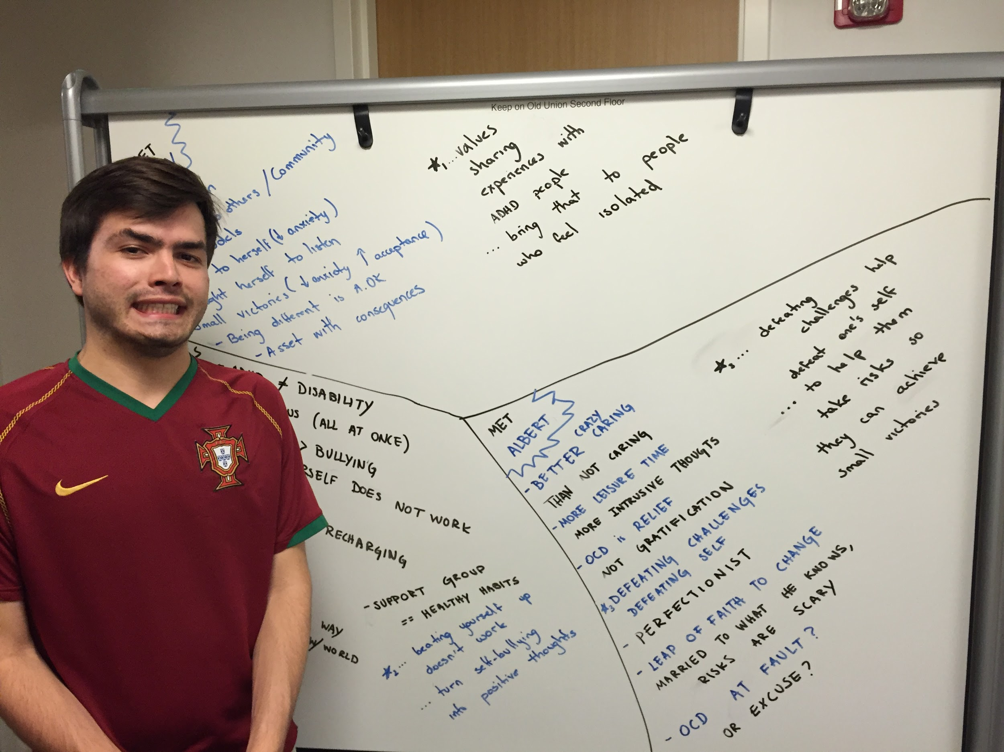
Us

Slide 3
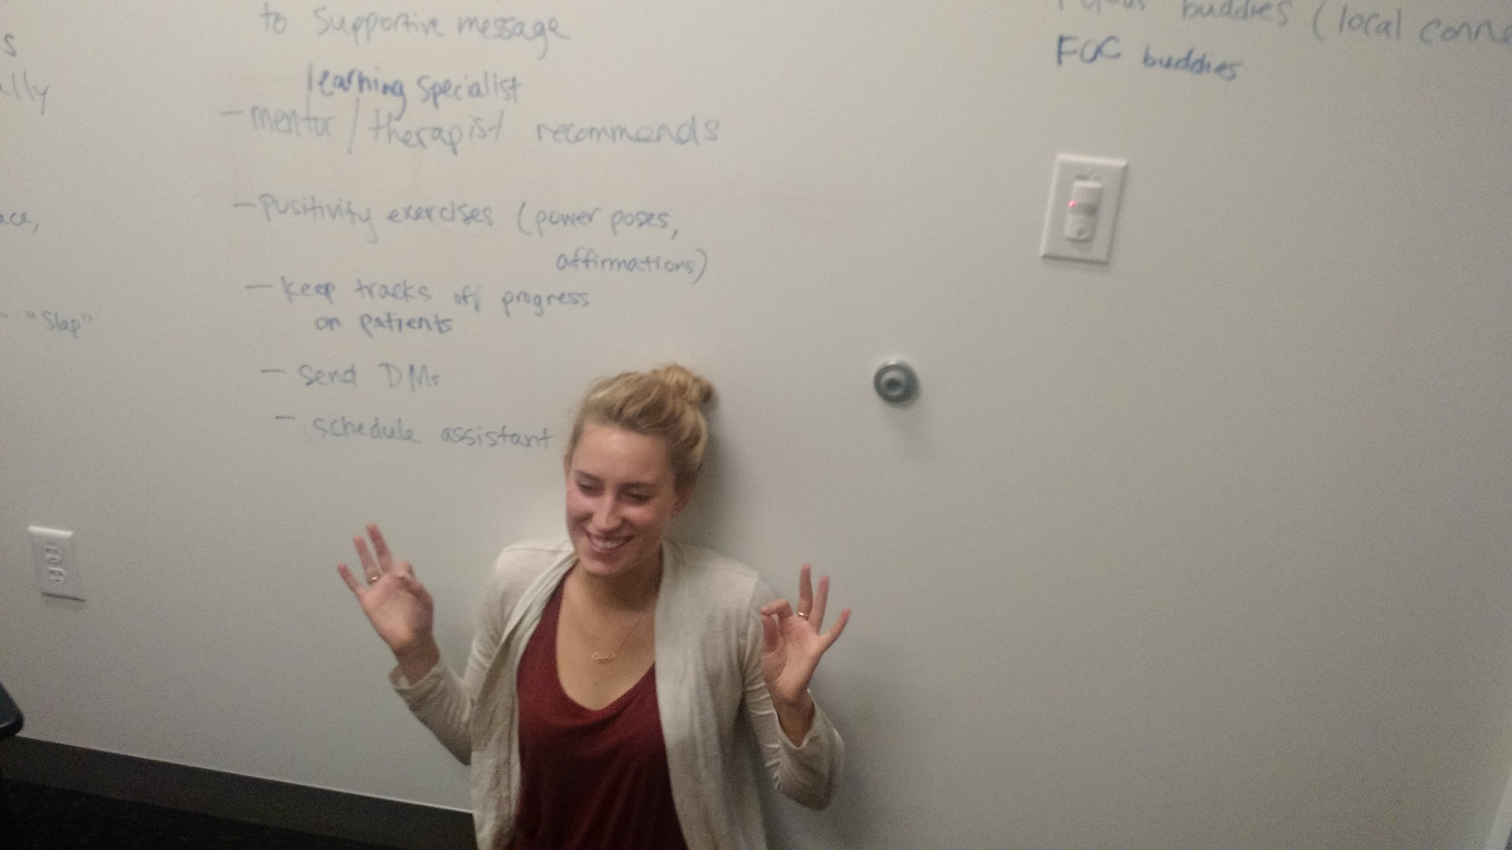
Us

Slide 4
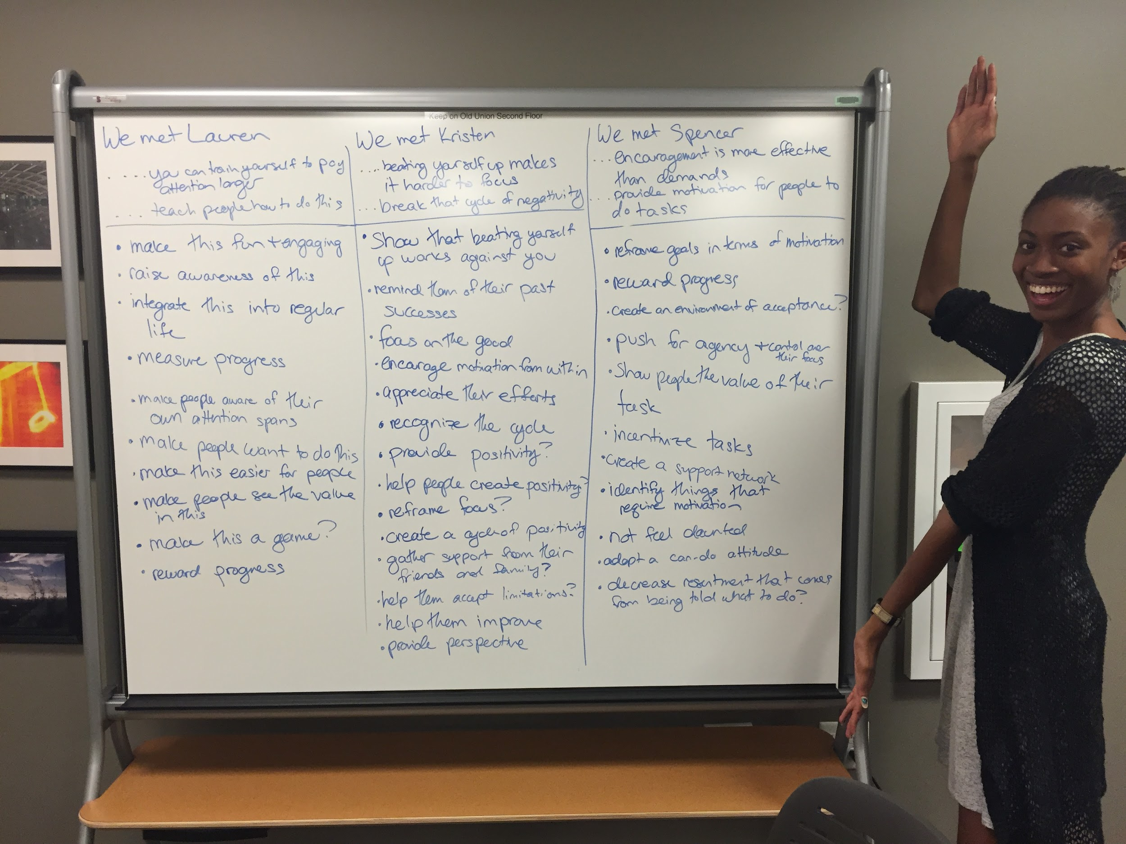
Us

Slide 5
PROBLEM DOMAIN
designing for people with attention disorders ➔ to better handle anxiety surrounding focus

Slide 6
Initial POVs
It would be game-changing to:
teach people how to train themselves to pay attention longer.
break the cycle of negativity that makes it harder to focus
provide motivation rather than demand for people to do tasks

Slide 7
NEEDFINDING RESULTS
We interviewed Ollie, Alberta, and Brian.

Slide 8
NEEDFINDING RESULTS
We interviewed Ollie, Alberta, and Brian.

Slide 9
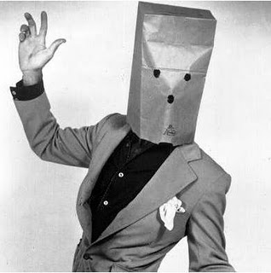
NEEDFINDING RESULTS
We interviewed Ollie, Alberta, and Brian.

Slide 10
NEEDFINDING RESULTS
Support from family and friends is very important
ADHD is not a disability--it’s a different way of seeing the world
ADHD people do not need a product. They need an attitude shift
Overcoming obstacles can boost your confidence and allow you to overcome personal struggles

Slide 11
POVs & HMWs

Slide 12
We met Ollie, who has ADHD.
We were amazed to realize that he values sharing experiences with other people with ADHD.
It would be game changing to bring that connection to people who feel isolated.
[POV 1]

Slide 13
HOW MIGHT WE…
Find a safe space, not distracting, for them to share experiences
Help people realize being different is okay, through community
Lessen anxiety about focus using discussion
[POV 1]

Slide 14
We met Brian, who also has ADHD.
We were amazed to realize that beating yourself up “doesn’t work.”
It would be game changing to turn self-defeating thoughts into positive ones.
[POV 2]

Slide 15
HOW MIGHT WE…
Raise awareness of negative thought cycles
Promote self-appreciation and motivation to those that do not believe in it
Teach emotional maturity in handling negative thoughts
[POV 2]

Slide 16
We met Alberta, who has OCD.
We were amazed to realize that overcoming external challenges helps her overcome her inner challenges.
It would be game changing to help people take risks to achieve small victories.
[POV 3]

Slide 17
HOW MIGHT WE…
Make taking risks and accomplishing things fun
Show people that they are capable of success
Gamify leaving your comfort zone by reframing it as an opportunity for success
[POV 3]

Slide 18
EXPERIENCE PROTOTYPES

Slide 19
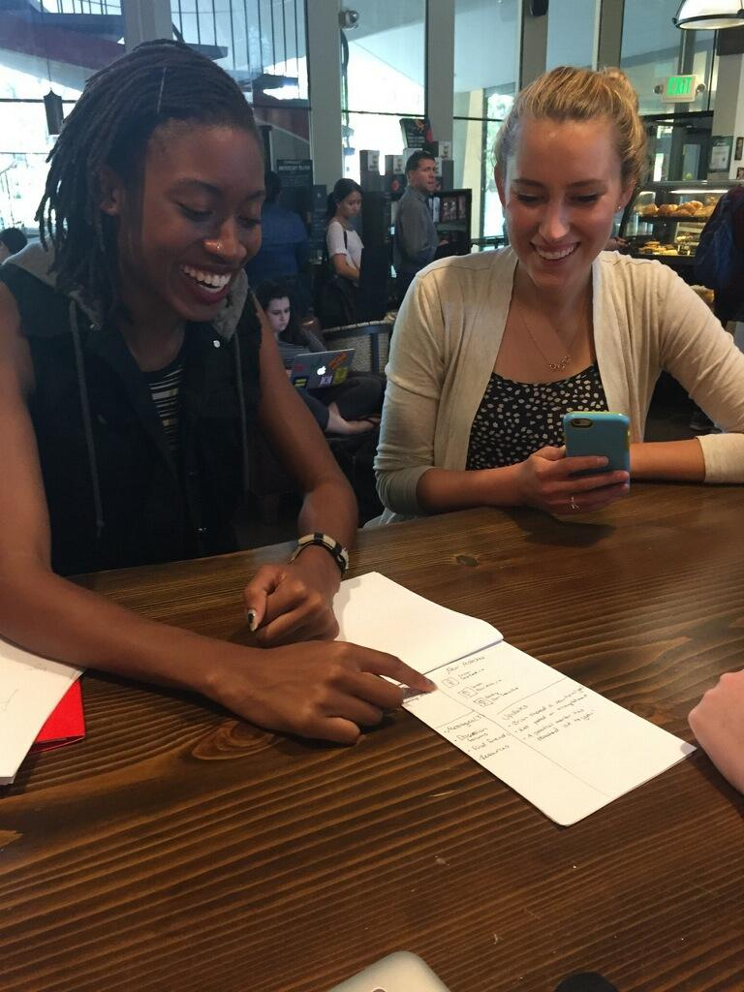
EXPERIENCE PROTOTYPE TESTING
Sketched some UIs on paper
Tested each of them with 3 Stanford students

Slide 20
EXPERIENCE PROTOTYPE [ 1 ] - Focus and Chill
Motivation: people want to meet people with ADHD who won’t judge them for being different
Solution: Online community that connects people with ADHD for friendship or mentorship
send private messages & meet-up invites
find resources
discuss issues

Slide 21
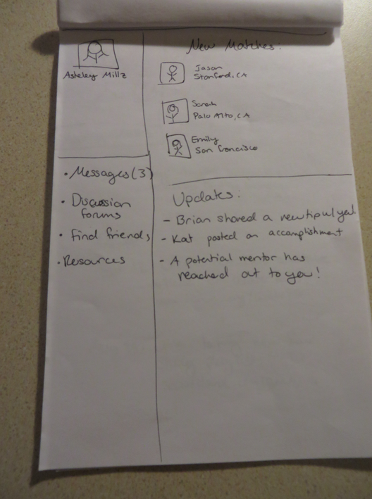
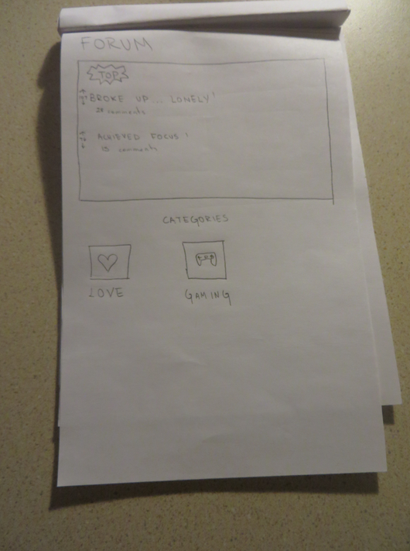
EXPERIENCE PROTOTYPE [ 1 ] - Focus and Chill

Slide 22
EXPERIENCE PROTOTYPE [ 1 ] - Focus and Chill
Worked:
Looking for and providing mentorship is cool
Location-based matching
Didn’t work:
Profile page with “wall” -- don’t be another social website

Slide 23
EXPERIENCE PROTOTYPE [ 2 ] - Focal Point
Motivation: therapy is a good way to turn negativity around
Solution: “ADHD homepage” for a more centered experience
make appointments or talk to your doctor
surround yourself with positivity
find resources

Slide 24
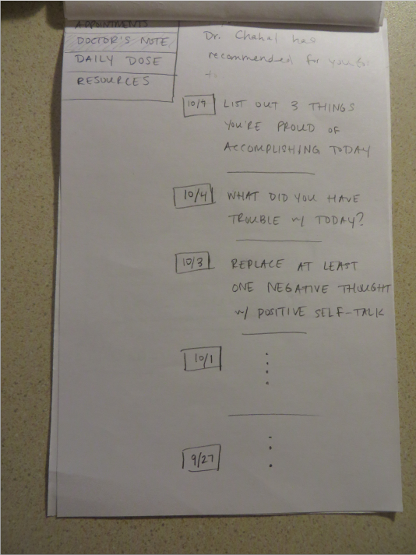
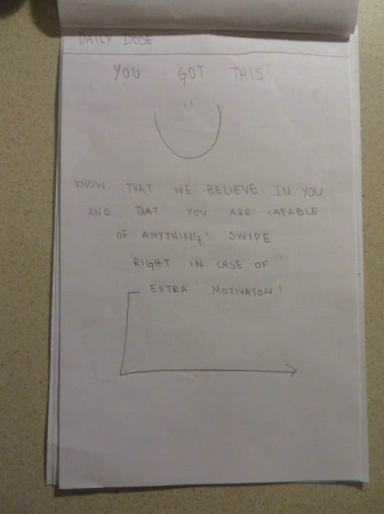
EXPERIENCE PROTOTYPE [ 2 ] - Focal Point

Slide 25
EXPERIENCE PROTOTYPE [ 2 ] - Focal Point
Worked:
Variety of resources
Gets to the root of ADHD
Lauren, a learning specialist from the OED, loved it
Didn’t work:
A bit clinical
Need more free resources

Slide 26
EXPERIENCE PROTOTYPE [ 3 ] - Slaptitude
Motivation: being silly and having fun makes you more willing to test your limits
Solution: Simple game that pushes the limits of your attention span
If you look at your phone before the time is up, you get “slapped”
Increase or decrease your time limit depending on success
Leaderboard with all your friends

Slide 27
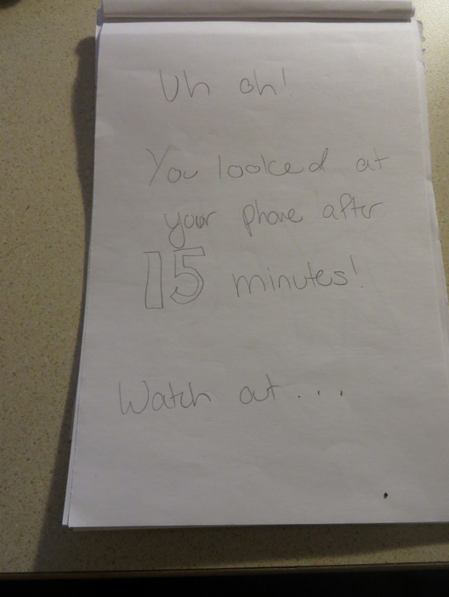
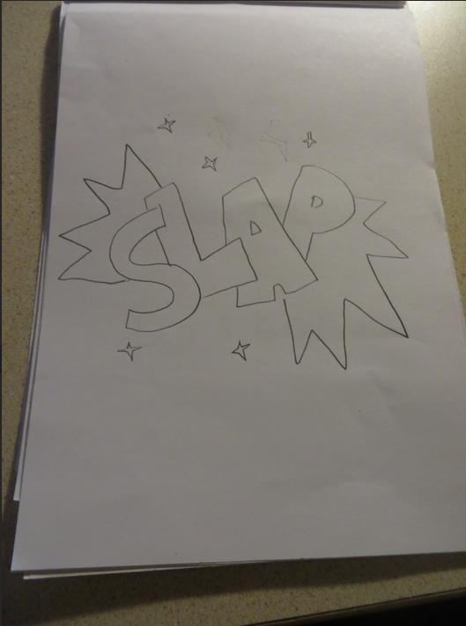
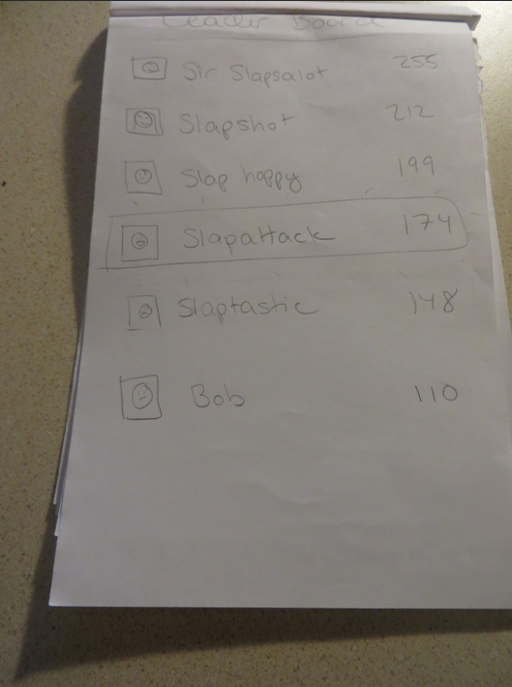
EXPERIENCE PROTOTYPE [ 3 ] - Slaptitude

Slide 28
EXPERIENCE PROTOTYPE [ 3 ] - Slaptitude
Worked:
Very playful and accessible to everyone
Leaderboard makes it competitive and engaging
Didn’t work:
Maybe not physical slaps?
Could make it more game-like: ”help Mario cross the bridge!”

Slide 29
NEXT STEPS
Our goal moving forward to is to reframe
“I’m doing my best ...but can’t do any better” into:
… I know my limits and accept where I am.”
… I need external support.”
… I can do better!”

Slide 30
QUESTIONS?

